Slide 1

AIRBNB Analytics Case Study
OBJECTIVES
1. Decide upon a minimum number of images to be made mandatory for a listing that would ensure bookings.
2.Come up with an optimal number of images that the host can post along with a listing that would attract the most bookings and ensure success.
CONCLUSION OF ANALYSIS
1. Mandatory number of images for a listing to ensure booking should be at least 6
2. Optimum number of images for a listing to attract most bookings should be around 14-15

Slide 2

1
Assumptions and Methodology Used
ASSUMPTIONS
CLEANING
FEATURE ENGINEERING
SOFTWARES USED
# Photos/Listing size is same: According to different size of listings, optimal number of photos might increase/decrease. Eg) A 2-room listing require different number of optimal photos compared to a 7 room Villa
Average duration for each Booking in a span of 5 years is assumed 3 days for Asia Pacific cities & 4 days for rest cities across world. Source – Link This will be used to calculate Booked Days = #Bookings * AvgnightsPerBooking
SuperHosts are hosts who have higher than average Ratings & good number of reviews on their Listings, compared to Regular Host
Total Listings in Redundant_Listings table is for same time period as in Open_Listings table, i.e 1 year before Aug 31, 2019.
Unorganized Posting_Date in Listing table : Around 40% of dates data showed Month as Day and vice-versa. This had to be transformed to get the correct Listing age of the Airbnb.
Listings Table
Listing Age: Age of AirBnb listing on the platform is calculated as 31st Aug, 2019 – Posting_Date
Booked Days: Booked Days of a listing is calculated as #Bookings * AvgNightsperBooking of that city.
Occupancy Rate: Percent Occupancy of any Listing over its lifetime is calculated as Total Booked days/Listing age.
Avg Booking Frequency: This is calculated as Listing Age/#Bookings of any listing.
Redundant_Listings Table
Booking Percent: For each image category, Booking percent is Total - Redundant listings/Total listings
Open_Listings Table
Open Percent by Image category: Calculated as #Open listings for particular image category / Total open listings across all image categories for given date
Python: For all Cleaning and Data Manipulation and Feature Engineering
Excel: For exploratory data analysis and calculating percentages
Tableau: For making charts and Visualizations and generating insights out of data

Slide 3

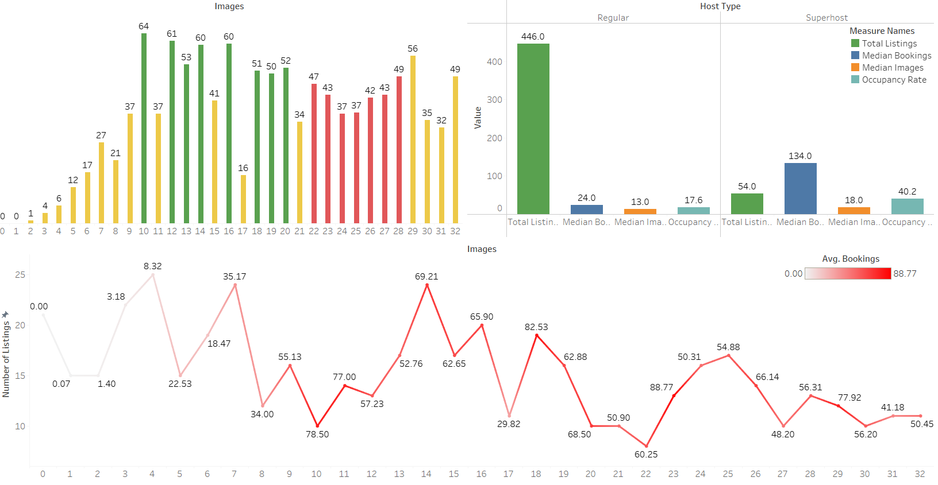
2
LISTINGS visualization & INSIGHTS
Objective: To check for the optimal number of images that can assure Hosts to attract most Bookings.
Key Insights: 1. Listings with images b/w 10-20 have the Highest Bookings & these Bookings decreases once the listings posts 20+ images.
2. While Listing, more users have posted <5 images, but their avg Bookings is very low (faded Red Line) compared to less no. of hosts who posted b/w 11 to 20 images.
3. Median Bookings and Occupancy Rate of Super Hosts are higher compared to Regular Hosts, deduced by higher number of Images for Super Hosts, that is 18.
Process
1
3
2
Conclusions
One can conclude from here that the optimum number of images for any listing should be around 14-15

Slide 4
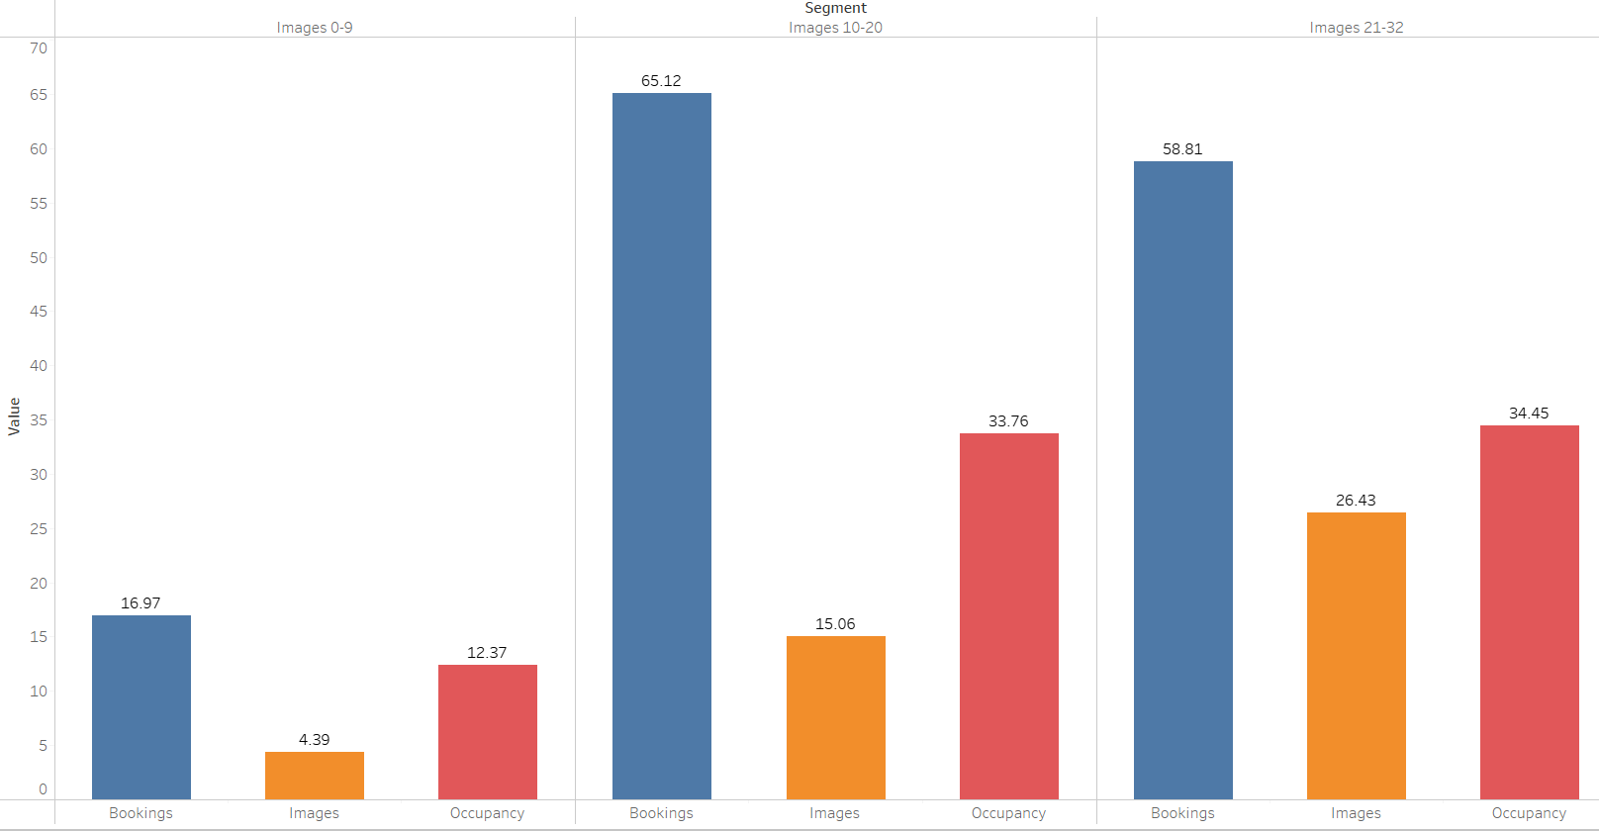
3
Segmentation of listings using k-means
Key Insights: 1. Listings with average 5 images have lower booking and very low Occupancy rate as well.
2. Listings with average 15 images had the highest Bookings on average and also had similar highest Occupancy Rate as for listings with average 25 images
3. As the average images for a listing increases to 25, occupancy rate remains same, though we see a decrease in average Bookings.
Process
Conclusions
One can conclude from here that the optimum number of images for any listing should be around 14-15

Slide 5
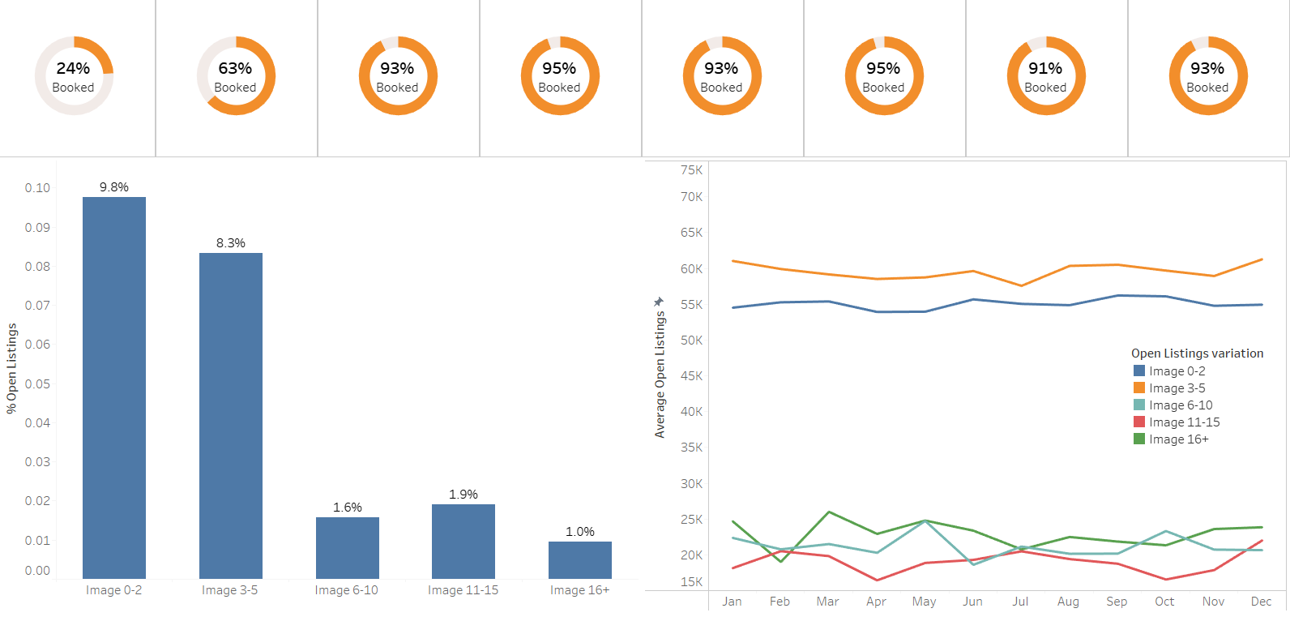
4
Open & Redundant Listings INSIGHTS
Key Insights: 1. There is a sharp 30% increase in the Booking Rate as the posted images moves to 6-10 category and then remains almost constant for further increase in images.
2. Out of total Listings for given image category, % Open/Redundant Listings are relatively higher for ones with less than 6 images.
3. Across whole year, Average Open Listings are highest for ones with <5 images and lowest for ones with 11-15 images.
Process
1
Image 0-2
Image 3-5
Image 6-10
Image 11-15
Image 15-20
Image 21-25
Image 26-30
Image 30+
2
3
Conclusions
One can conclude from here mandatory number of images for a listing to ensure booking should be at least 6

